Slide 1
CAPSTONE PROJECT
SQL
PYTHON
TABLEAUE
MENTOR NAME : JAYA PANDEY
STUDENT NAME : AVINAASH ALFRED.R

Slide 2
CONTENTS FOR PYTHON
INTRODUCTION
OBJECTIVES
DATA ANALYSIS USING PYTHON QUESTIONS AND ANSWERS
INTERPRETATION
VISUALIZATION OF PYTHON
OBSERVATION
CONCLUSION

Slide 3
INTRODUCTION
TMDB provides an API(Application programming interface) and downloadable datasets that contain information on thousands of movies and TV shows. Analysts and data scientists can access this data to perform various types of analyses.
The TMDB movie data analysis can vary widely. Common goals include understanding audience preferences, predicting box office success, assessing the impact of genres, analyzing actor/director influence, and evaluating the relationship between ratings and revenue.
Before diving into analysis, it's essential to explore the dataset. This involves checking for missing data, understanding data types, and gaining a general overview of the dataset's structure.
Basic statistics can help provide insights into key metrics like movie budgets, revenue, ratings, and popularity. Common statistics include mean, median, standard deviation, and quartiles.
Visualization tools such as bar charts, scatter plots, and histograms can make the data more accessible and provide insights into trends and patterns. For example, visualizing the distribution of movie ratings or budget vs. revenue relationships can reveal interesting patterns.

Slide 4
OBJECTIVES
Revenue Maximization: Identify key factors influencing high revenue-generating movies to optimize revenue generation strategies and inform decision-making for future movie projects.
Budget Optimization: Determine the relationship between movie budgets and their impact on revenue to optimize budget allocation and ensure efficient resource management for upcoming movie productions.
Performance Benchmarking: Analyze the performance of movies based on their budgets and revenues to set benchmarks for success and evaluate the performance of future movie releases against these benchmarks.
Market Trend Identification: Identify trends in viewer preferences, genres, or other movie attributes to anticipate market demand and align future movie projects with emerging trends for increased market competitiveness.
Risk Mitigation and Decision Support: Evaluate the performance of high-budget and low-budget movies to provide insights for risk assessment and informed decision-making in budget allocation and project planning for future movie productions.
Competitive Analysis and Positioning: Compare the performance of the analyzed movies with industry competitors to identify areas of competitive advantage and opportunities for strategic positioning within the market.

Slide 5
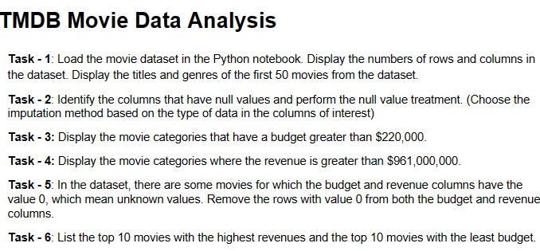
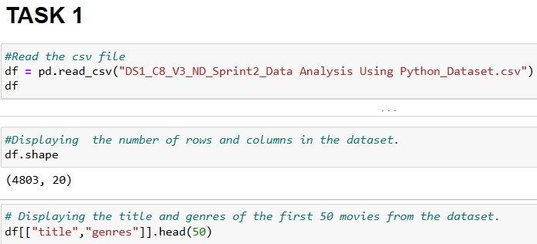
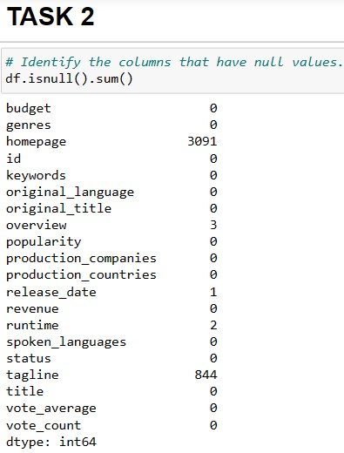
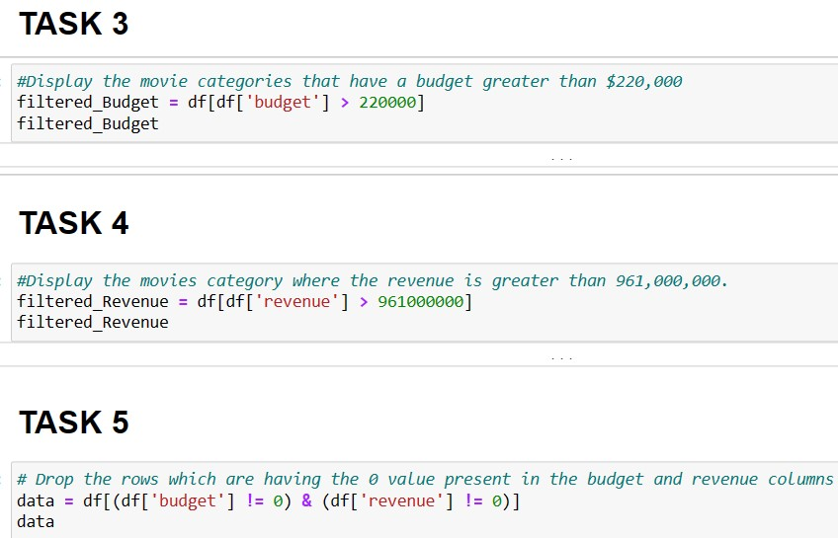
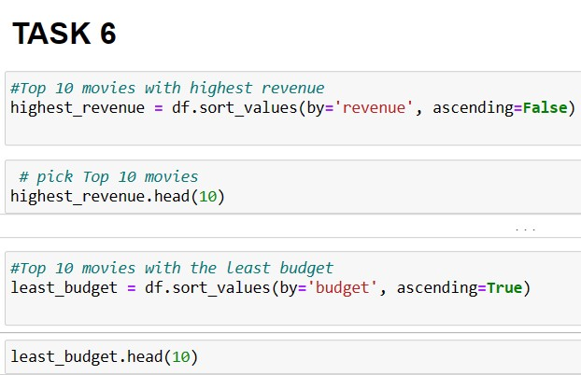
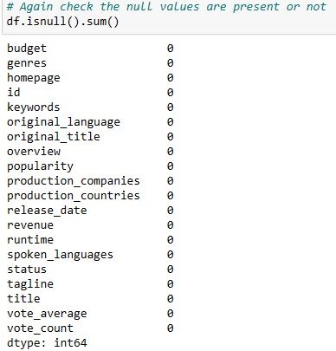
DATA ANALYSIS USING PYTHON QUESTIONS AND ANSWERS

Slide 6
INTERPRETATION
Task 1: Loading the dataset and displaying the number of rows and columns helps understand the dataset's size and complexity. Displaying the titles and genres of the first 50 movies provides an initial glimpse into the movie categories and themes present in the dataset, giving a brief overview of the diversity of movies included.
Task 2: Identifying columns with null values and performing appropriate treatments ensures that the dataset is free from missing or incomplete data. The choice of imputation method is crucial and should be based on the specific data types and characteristics of the columns in question, ensuring that the dataset remains consistent and reliable for subsequent analysis.
Task 3: Displaying movie categories with budgets exceeding $220,000 highlights the investment trends within different genres. Understanding which categories demand higher budgets provides insights into the production costs associated with different types of movies, offering a glimpse into the financial aspects of filmmaking within specific genres.
Task 4: Identifying movie categories with revenues surpassing $961,000,000 offers insights into the most commercially successful genres. This analysis helps stakeholders understand the types of movies that have resonated well with audiences and have achieved significant financial success, providing valuable information for making strategic decisions regarding future investments and productions.
Task 5: Removing rows with zero budget and revenue values ensures that the subsequent analysis is based on reliable and meaningful information, as these values indicate missing or unknown data. This data cleaning process guarantees that the analysis is accurate and reliable, providing a solid foundation for deriving insights and making data-driven decisions.
Task 6: Listing the top 10 movies with the highest revenues and the top 10 movies with the least budget provides valuable insights into the performance and financial success of various movies. Understanding the characteristics and factors that contribute to the success of high-earning movies and the effective management of low-budget productions can serve as benchmarks for future investment and production strategies, enabling stakeholders to make informed decisions and optimize their resources effectively.

Slide 7
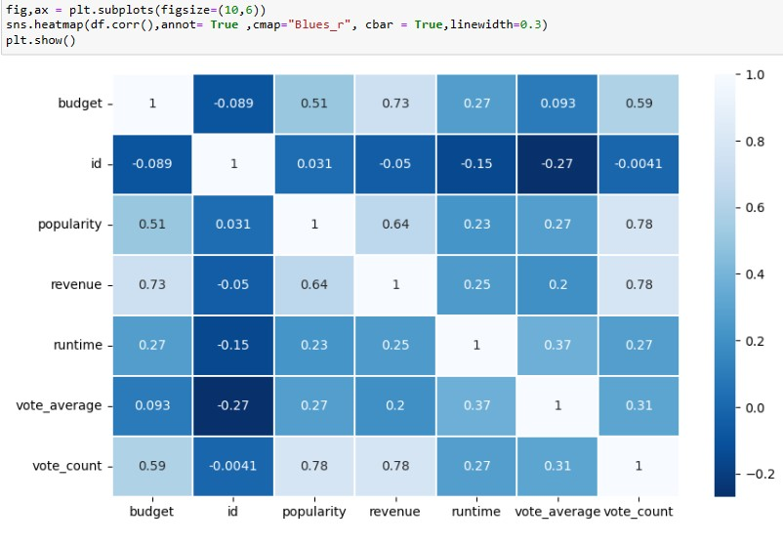
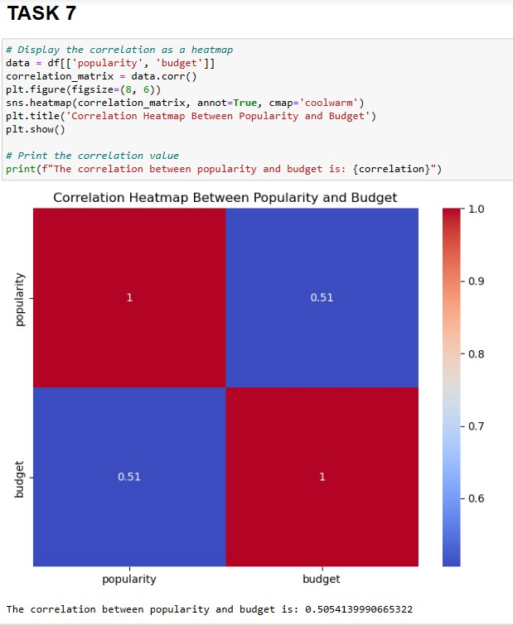
VISUALIZATION OF PYTHON
INTERPRETATION
If the heatmap shows a color closer to red, it indicates a positive correlation between popularity and budget, suggesting that as the budget increases, the popularity tends to increase as well.
If the heatmap shows a color closer to blue, it suggests a negative correlation between popularity and budget, implying that as the budget increases, the popularity decreases.
The correlation value provides a numerical representation of the relationship, with values close to 1 indicating a strong positive correlation, values close to -1 indicating a strong negative correlation, and values close to 0 suggesting a weak or no linear correlation between popularity and budget.

Slide 8

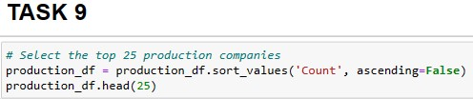
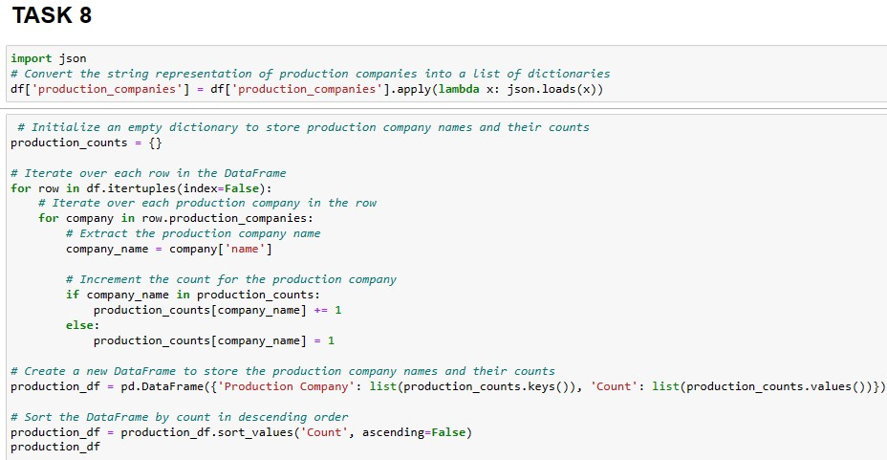
INTERPRETATION:
Task 8: Identifying and displaying the names of all production companies along with the number of times they appear in the dataset provides valuable insights into the diversity and distribution of production companies involved in the movies included in the dataset. By understanding the frequency of appearance of each production company, stakeholders in the film industry can gain a comprehensive overview of the competitive landscape and the level of contribution of different production companies to the overall dataset.
Task 9: Displaying the names of the top 25 production companies based on the number of movies they have produced in descending order helps identify the most prolific production companies within the dataset. This analysis sheds light on the key players in the film industry and their respective contributions to the overall movie production landscape. By understanding which production companies have produced the most movies, stakeholders can gain insights into the industry's dominant players and their influence on the market, potentially guiding future collaborations, investments, and strategic partnerships.

Slide 9
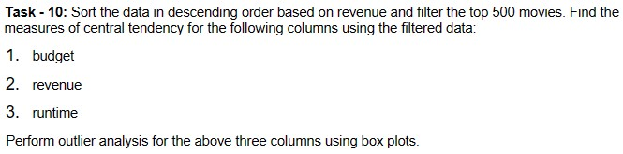
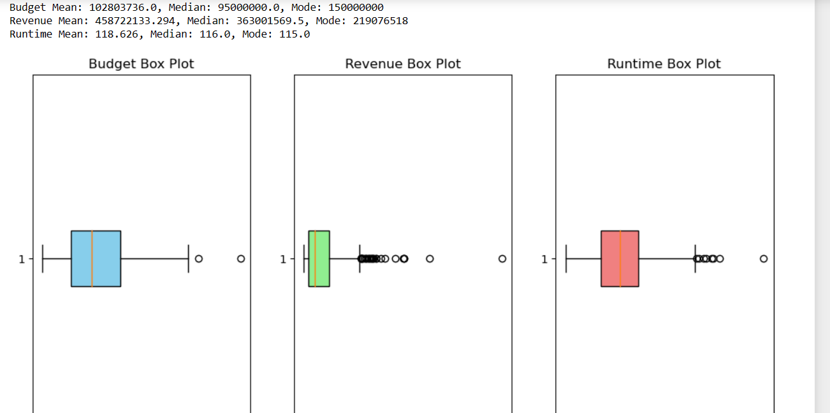
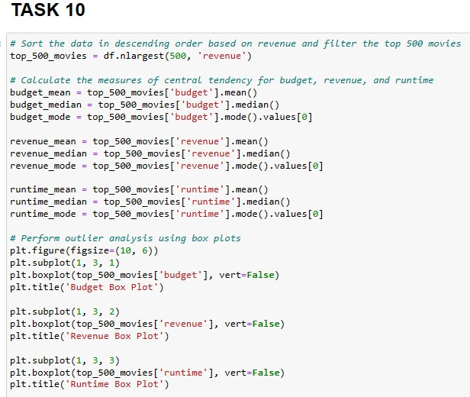
INTERPRETATION:
Sorting and Filtering Data: Sorting the movie data based on revenue and filtering the top 500 movies allows us to focus on the most successful movies in terms of revenue, providing a clearer understanding of the trends in the dataset.
Measures of Central Tendency:
Budget: The mean, median, and mode of the budget provide insights into the average, central, and most frequent values, respectively, for the budgets of the top 500 movies.
Revenue: Similar to budget, the mean, median, and mode of the revenue provide insights into the average, central, and most frequent values for the revenues of the top 500 movies.
Runtime: The mean, median, and mode of the runtime provide insights into the average, central, and most frequent durations, respectively, for the top 500 movies.
Box Plots:
Budget Box Plot: The box plot provides a visual representation of the distribution of the budgets of the top 500 movies, including information on the median, quartiles, and any outliers.
Revenue Box Plot: Similarly, the revenue box plot visually represents the distribution of the revenues of the top 500 movies, showcasing the median, quartiles, and any outliers.
Runtime Box Plot: The runtime box plot visually represents the distribution of the runtimes of the top 500 movies, including the median, quartiles, and any outliers.

Slide 10
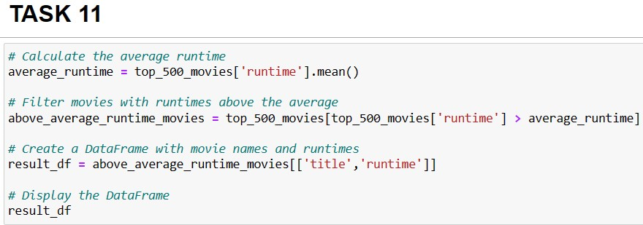
Task 11:
By identifying and displaying the names of movies with runtimes above the average, stakeholders in the film industry can gain an understanding of the characteristics of movies that typically have longer durations. This analysis can help identify patterns or genres that often require more extended storytelling or elaborate plot development. Understanding the movies with above-average runtimes can assist filmmakers, producers, and distributors in making informed decisions regarding content planning, scheduling, and audience engagement strategies. It can also provide insights into audience preferences for certain types of movies that offer more extensive and immersive storytelling experiences.

Slide 11
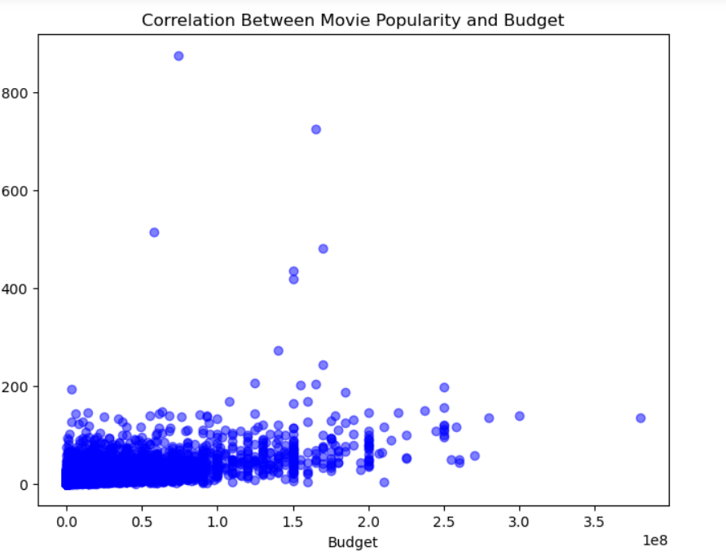
OBSERVATION

Slide 12
CONCLUSION
The film industry is a complex ecosystem where multiple factors contribute to the success and popularity of movies. While a higher budget can often lead to increased revenues, it is not the sole determinant of a movie's success. Factors such as effective marketing, engaging storytelling, and audience preferences play a crucial role in shaping the performance of a movie. Additionally, the landscape of production companies is diverse, with certain entities emerging as dominant players, significantly influencing the overall production dynamics.
Understanding audience preferences, runtime trends, and the contributions of various production companies is essential for making informed decisions about resource allocation, content planning, and marketing strategies. The success of a movie often hinges on a combination of factors, including creative storytelling, strategic budgeting, and effective marketing, aimed at engaging audiences and creating memorable cinematic experiences.
By leveraging these insights, stakeholders in the film industry can adapt their strategies to meet audience expectations, foster creative innovation, and drive sustainable growth. Overall, a holistic understanding of the interplay between budget, production dynamics, audience preferences, and storytelling is pivotal for creating successful and impactful movies that resonate with audiences and contribute to the continued evolution of the film industry.

Slide 13
THANK YOU

